Slide 1
Chapter 6
Differential Equations [微分方程]

Slide 2
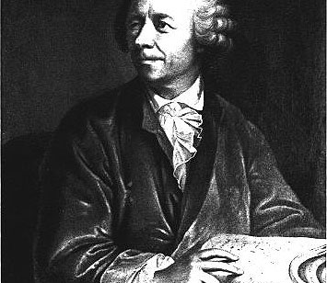
Section 6.1
Basic Concepts of Differential Equations

Slide 3
Examples of Differential Equations
Example 1
Suppose that a plane curve passed through the point (1,2) in
the xOy plane. The slope of the tangent at any point (x, y) to the curve is
2x. Find the equation of the curve.
Solution
By the geometric meaning of derivatives, the desired
curve y = f(x) should satisfy
differential
equation
Initial
condition
.
Integrating on both sides of the 1st equation with respect to x, we obtain

Slide 4
Examples of Differential Equations
Example 1
Suppose that a plane curve passed through the point (1,2) in
the xOy plane. The slope of the tangent at any point (x, y) to the curve is
2x. Find the equation of the curve.
Solution (continued)
where C is an arbitrary constant. It can be evaluated by the initial condition.
Substituting the initial condition to the last
equation, we have
Therefore, the equation of the desired curve is
Finish.

Slide 5
Examples of Differential Equations
Example 2
Suppose that a particle with mass m falls freely from
a position of height H, with initial velocity V₀. If we neglect the resistance of air, find the relationship between the height H and time t while the particle is falling.
Solution
Denote the initial time when the particle starts
to fall by t = 0, and denote the height of the particle at any time t in the process of falling by h = h(t).
By Newton’s second law, h should satisfy the following
equation
H
differential
equation
h(t)
Initial
conditions

Slide 6
Examples of Differential Equations
Example 2
Suppose that a particle with mass m falls freely from
a position of height H, with initial velocity V₀. If we neglect the resistance of air, find the relationship between the height H and time t while the particle is falling.
Solution (continued)
Integrating both sides of the last equation twice, we have
H
Substituting the initial condition to the above
equation yields
h(t)
Finish.
Notes:
Where C1 and C2 are arbitrary constants.

Slide 7
Basic Concepts
Definition (Differential equation)
An equation is called a differential
equation (微分方程) if it contains the derivative or differential of
an unknown function.
Example:
and
are both differential equations.
Definition A differential equation in which the unknown function y is a univariate function, is called an ordinary differential equation (常微分方程) and will be referred as differential equation(微分方程).
The order of the highest order derivative of the unknown function in the equation is called the order(阶) of the equation.

Slide 8
Basic Concepts
Example:
First-Order
Second-Order
The general form of a first order differential equation may be
expressed by
and F(x,y) is a function which depends on the independent variable x and the dependent variable y.

Slide 9
Basic Concepts
Definition (Solution, General Solution, Initial Conditions and Particular Solution)
If a function y = f (x) satisfies a given differential equation, then the function y = f (x) is called a solution (解) of the equation.
If the solution contains arbitrary constants and the number of the independent constants just equals the order of the equation, then this solution is called the general solution (通解) of the equation.
If all the arbitrary constants in a solution have been determined, then the solution is called a particular solution (特解) of the equation.
The additional conditions are called the initial conditions (初始条件) of the equation.

Slide 10
Fundamental Concepts of Differential Equations
Note that the general solution may not be the total solutions.
Example

Slide 11
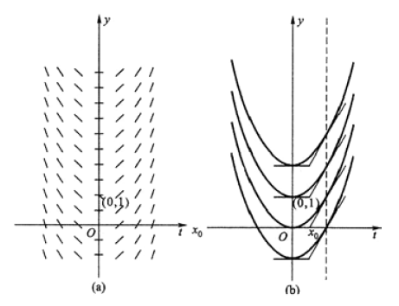
Geometric Interpretation of the First Order Differential Equation

Slide 12
Geometric Interpretation of the First Order Differential Equation
Slope Fields: Viewing Solution Curves
Each time we specify an initial condition y ( x₀) = y₀ for the solution of a differential equation , the solution curve (graph of the solution) is required to pass through the point (x₀, y₀) and to have slope f (x₀, y₀) there.

Slide 13
Geometric Interpretation of the First Order Differential Equation
Slope Fields: Viewing Solution Curves
We can picture the slopes graphically by drawing short line segments of slope f (x, y) at selected points (x, y) in the region of the xy-plane that constitutes the domain of f. Each segment has the same slope as the solution curve through (x, y) and so is tangent to the curve there. We see how the curves behave by following these tangents.

Slide 14
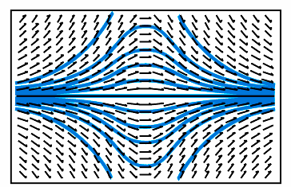
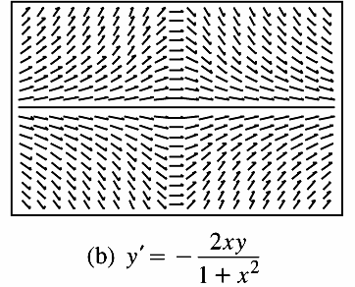
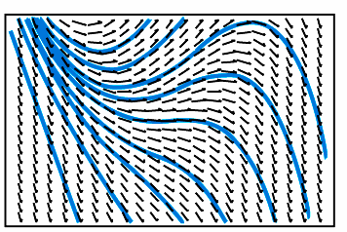
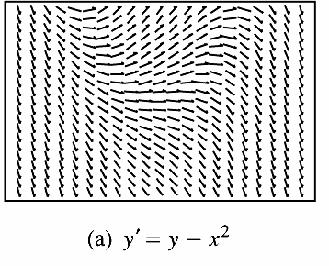
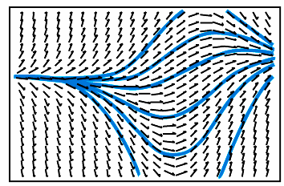
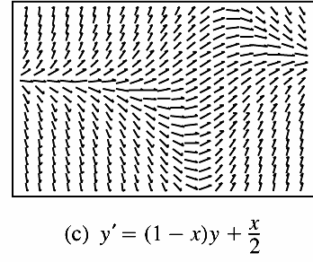
Slope Fields

Slide 15
Section 6.2
First-Order Differential Equations

Slide 16
First-Order Separable Differential Equations 一阶可分离变量方程
The general form of a first-order differential equation is
F(x, y, y′) = 0.
If this equation can be solved for y′, it can be written in the form
y′ = f(x, y).
Definition (First-order equations with variables separable)
The equation
is separable (可分离变量的)
if F is the product of a function of x and a function of y. The
differential equation then has the form

Slide 17
First-Order Separable Differential Equations 一阶可分离变量方程
Separation of
Variable
分离变量法
h(y₀) = 0
total solutions

Slide 18
First-Order Separable Differential Equations
Example 1
Find the general solution of the equation
Solution
It is easy to see that the equation has variables separable.
Let
separating variables we have
Integration on both sides gives
so that

Slide 19
First-Order Separable Differential Equations
Example 1
Find the general solution of the equation
Solution (continued)
Hence
or
where
is an arbitrary non-zero constant.
It is obvious that y = 0 is also a solution of the given equation, and we can see that it may be included in the general solution if the constant C is allowed to be zero. Therefore, the general solution of the given equation is , when C is an arbitrary constant and this is also the total solution of the equation.
Finish.

Slide 20
First-Order Separable Differential Equations
Example 2
Solve the differential equation
Solution
Since 1 + y² is never zero, we can solve the equation
by separating the variables.
Treat dy/dx as a quotient of differentials and multiply both sides by dx
Divide by (1 + y²).
Integrate both sides.
C represents the combined constants
of integration.

Slide 21
First-Order Separable Differential Equations
Example 2
Solve the differential equation
Solution (continued)
The equation
gives y as an
implicit function of x.
When
, we can solve for y as an explicit
function of x by taking the tangent of both sides:
Finish.

Slide 22
Homogeneous Equation (齐次微分方程)
Definition (homogeneous equation) If an equation is of the form:
where f is any continuous function, then it is called a homogeneous equation (齐次微分方程).
For instance,
and
homogeneous equations
Since, equation
it is also homogeneous equation.

Slide 23
Homogeneous Equation
To solve the homogeneous equation, let , or , so
Then the differential equation becomes to
or
This is a separable equation. If we find the solution u = u(x, C), the general solution of the original equation can be obtained by the substitution
or

Slide 24
Homogeneous Equation
Example 3 Find the general solution of the equation
Solution
Dividing by x on both sides of the equation and
transposing terms we have
This is a homogeneous equation. Let , or , then
Substituting into the equation, we have

Slide 25
Homogeneous Equation
Example 3 Find the general solution of the equation
Solution (continued) Solving by separation of variables we have
Integrating on both sides,
or
By the transformation
, we obtain the general solution of the
given equation
or
It is easy to see that u = 0 also satisfies the equation.

Slide 26
Homogeneous Equation
Example 3 Find the general solution of the equation
Solution (continued)
Note that u = 0 is equivalent to y = 0; thus y = 0 is also a solution of the given equation. But it is easy to see that y = 0 is not contained in the general solution ( it can not be obtained from the general solution by choosing the constant C). Therefore the total solution of the given equation is
Finish.

Slide 27
Homogeneous Equation
Example 4 Find the general solution of the equation
Solution
This is a homogeneous equation. Let , or , then
i.e.
Therefore,
By the transformation
, we obtain the general solution of the
given equation
Finish.

Slide 28
Linear First-Order Differential Equations
Definition (Linear First-Order Differential Equation)
A first-order
differential equation that can be written in the form
or
(1)
where P and Q are functions of x, are a linear first-order equation (一阶线性微分方程) and this equation is the equation’s standard form.
If Q(x) ≡ 0, then equations become to
or
(2)
which are called a homogeneous linear differential equation (齐次线性微分方程), and if Q(x) is not always zero, the corresponding equations are called a nonhomogeneous linear differential equation (非齐次线性微分方程).

Slide 29
Homogeneous Linear differential Equation
It is easy to see that the homogeneous linear equation
may be solved by separation of variables as follows:
Integration of both sides gives
so
(3)
where C is an arbitrary constant. This is the general solution of the homogeneous linear differential equation.

Slide 30
Nonhomogeneous Linear Differential Equation
How to solve the non-homogeneous linear differential equation?
We solve the equation
(4)
by method of variation of constants(常数变易法).

Slide 31
Nonhomogeneous Linear Differential Equation
(4)
Suppose that y = y(x) is a solution of the equation (4).
Then must be a function of x, denoted by h(x). Thus the desired solution has the form:
(5)
Hence, to find the solution, we need only determine the function h(x). Now
(6)
Notes:
The term with red line is the term used to substitute the constant C.
Substituting the last equation to the equation (6), we have the following solution.

Slide 32
Nonhomogeneous Linear Differential Equation
(4)
(5)
(6)
Substituting (5) and (6) into the equation (4), we have
or
Notes:
The term with red line is the term used to substitute the constant C.
Substituting the last equation to the equation (6), we have the following solution.

Slide 33
Nonhomogeneous Linear Differetial Equation
Thus, we have the general solution for the differential equation (4)
(7)
where C is an arbitrary constant. Also, the integration of function P(x) does not need more general solution.
The general solution of a non-homogeneous linear equation consists of the sum of one of its particular solutions and the general solution of the corresponding homogeneous linear equation.

Slide 34
Nonhomogeneous Linear Differential Equation
Example 5 Solve the equation
Solution I
Step 1. Put the equation in standard form to identify P and Q.
Step 2. Find the solution of the homogeneous equation
Step 3. Set then find h(x).

Slide 35
Nonhomogeneous Linear Differential Equation
Example 5 Solve the equation
Solution I
Then, the solution is
Finish.

Slide 36
Nonhomogeneous Linear Differential Equation
Example 5 Solve the equation
Solution II
Step 1. Put the equation in standard form to identify P and Q.
Step 2. Find an antiderivative of P(x) (any one will do).
Step 3. Substituting into the formula

Slide 37
Nonhomogeneous Differential Linear Equation
Example 5 Solve the equation
Solution II (continued)
The solution is
Finish.

Slide 38
Nonhomogeneous Linear Differential Equation
Example 6 Find the general solution of the equation
and the particular solution which satisfies the initial condition
Solution
Since the equation can be rewritten as follows
then it is a linear differential equation of first order with the unknown function
The corresponding homogeneous equations is

Slide 39
Nonhomogeneous Linear Equation
Example 6 Find the general solution of the equation
and the particular solution which satisfies the initial condition
Solution (continued)
By separation of variables, its general solution is
To find the general solution, we let C = h(x), and we obtain
so
Substituting this equation into the original equation, we have

Slide 40
Nonhomogeneous Linear Equation
Example 6 Find the general solution of the equation
and the particular solution which satisfies the initial condition
Solution (continued) So that
Thus the desired general solution is
Substituting the initial condition into the general solution, we obtain
Finish.

Slide 41
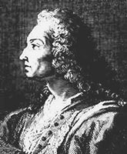
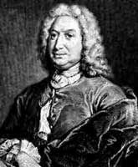
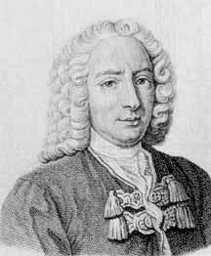
Bernoulli’s Equation
Definition An equation of the form
is called Bernoulli’s equation.
Bernoulli, Jakob
(1654-1705)
Swiss Mathematician
Bernoulli, Johann
(1667-1748)
Swiss Mathematician
Bernoulli, Daniel
(1700-1782)
Swiss Mathematician
Notes:
Jakob is the brother of Johann and Johann is the father of Daniel. They are both the important founders of calculus (with the exception of Newton and Leibniz)

Slide 42
Bernoulli’s Equation
Bernoulli’s equation can be reduced to a linear equation by a kind of
Transformation. To show this, dividing both sides of the equation
by we obtain
Let
, we have
Thus, we obtain
Therefore, the general solution of the given Bernoulli’s equation may be obtained from the general solution of the last equation by the transformation .
If we want to obtain the total solution, we need to check if y = 0 is also a solution.

Slide 43
Bernoulli’s Equation
Example 7 Find the general solution of the equation
Solution It is easy to see that the equation is a Bernoulli’s equation.
Dividing both sides of the equation by y³ we have
Let z = y ⁻² , so that
Substituting into the last equation,
we obtain
Then, its general solution is
Therefore, the general solution of the given equation is

Slide 44
Bernoulli’s Equation
Example 7 Find the general solution of the equation
Solution (continued) It is easy to see that y = 0 is also a solution of the given equation, but it can not be obtain from the general solution by choosing C.
Hence, the total solution is
Finish.

Slide 45
Some Other Kinds of Equations That Can Be Solved by Transformations of Variables
Example 8 Find the particular solution of the equation
satisfying the initial condition
Solution
This equation can be rewritten in the form:
then, let y ² = u, it becomes the linear equation
The general solution of the last equation is easily found to be
Thus the general solution of the given equation is
The initial condition
Finish.

Slide 46
Some Other Kinds of Equations That Can Be Solved by Transformations of Variables
Example 9 Find the general solution of the equation
Solution
Let u = x + y, so
. Thus the given equation may be
transformed into
By separation of variables we have
Thus,
and the general solution may be found by the transformation u = x + y.
Finish.

Slide 47
Some Other Kinds of Equations That Can Be Solved by Transformations of Variables
Example 10 Find the general solution of the equation
Solution
Since the right side of the given equation may be rewritten as
yln(xy), and the left side is just
, we try to make the transformation
u = xy. Then the given equation becomes to
This equation is not suitable because it contains three variables, but if we write
, it may be changed into
Separating variables we have

Slide 48
Some Other Kinds of Equations That Can Be Solved by Transformations of Variables
Example 10 Find the general solution of the equation
Solution (continued)
Taking integration on both sides, we have
that is,
Hence the general solution of the given equation is
Finish.

Slide 49
Some Other Kinds of Equations That Can Be Solved by Transformations of Variables
Example 10 Find the general solution of the equation
Note
We have seen that except for a few particular equations, solving
differential equations by transformations of variables is not very easy because it is hard to see in general how to find a suitable transformation. It requires some skills gained only by experience.

Slide 50
Section 6.3
Reducible Second-Order Differential Equations

Slide 51
Differential Equations of Second Order Solvable by Reduced Order Methods
In this part, we will introduce some methods for solving some kind of second order equations of the form
There are three types of equation of this form which can be solved by reduction of order methods. We will discuss them in the following.
Solving this type of equations is very simple. We need only integrate f(x) successively twice.
(1)
Example 1 Find the general solution of the equation
Solution
Since
and then
Finish.

Slide 52
Differential Equations of Second Order Solvable by Reduced Order Methods
The character of the equation is that the function f does not contain the unknown function y.
(2)
We make the transformation
, so that
Thus the equation is transformed into
This is a differential equation of first order. If we can find its general solution denoted by
then since
we have
Integration again, we obtain the desired general solution

Slide 53
Differential Equations of Second Order Solvable by Reduced Order Methods
Example 2 Find the particular solution of the equation
with the initial conditions
and
Solution
Let
then
Substituting into the equation
we have
Separating variables we obtain
Then, the general solution is

Slide 54
Differential Equations of Second Order Solvable by Reduced Order Methods
Example 2 Find the particular solution of the equation
with the initial conditions
and
Solution (continued)
or
(1)
Integration again we obtain the general solution of the given equation that is
(2)
Substituting the initial conditions
into the equation (1)
and (2), respectively, we obtain that
and
Finish.

Slide 55
Differential Equations of Second Order Solvable by Reduced Order Methods
The character of the equation is that the function f does not contain the independent variable x.
(3)
We make the transformation
, so that
Thus the equation is transformed into
(3-1)
If we regard p as an unknown function and y as the independent variable in equation (3-1); then by the rule for differentiation of composite functions we have

Slide 56
Differential Equations of Second Order Solvable by Reduced Order Methods
Hence the equation (3-1) may be changed into
(3-1)
(3-2)
If the general solution of (3-2), denoted by p = g ( y , C₁ ), can be found then since p = y’ we have
Therefore, the general solution of the given equation is given by

Slide 57
Differential Equations of Second Order Solvable by Reduced Order Methods
Example 3 Find the general solution of the equation
Solution
Let
, so that
Substituting into the given equation we obtain
that is,
or
From p = 0, we have
so y = C.

Slide 58
Differential Equations of Second Order Solvable by Reduced Order Methods
Example 3 Find the general solution of the equation
Solution (continued)
From the equation
we can obtain
or
so that
It is easy to see that the solution y = C may be obtained from the general solution by choosing C₁ = 0. Therefore, the general solution of the given equation is the one shown in the last equation.
Finish.

